Slide 1
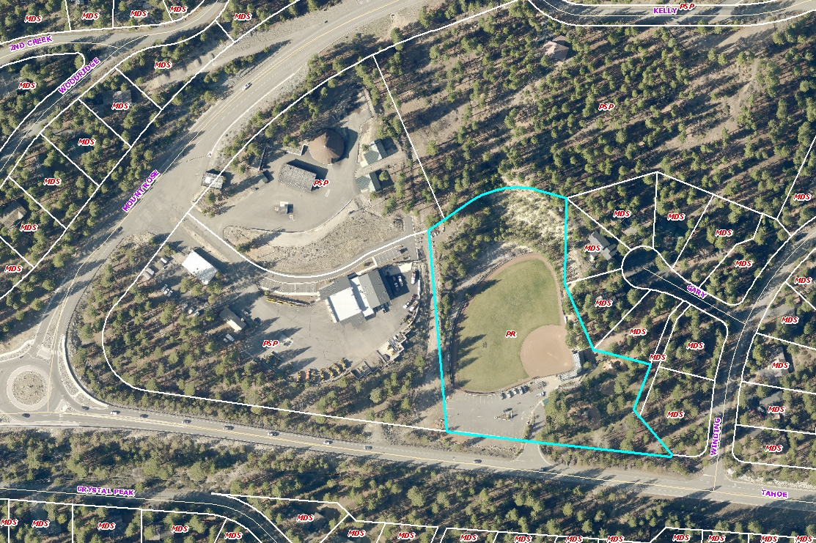
WADMIN19-0007
Incline Fine Arts Festival
Friday, August 9 to Sunday August 11, 2019
700 Tahoe Boulevard
Preston Field

Slide 2
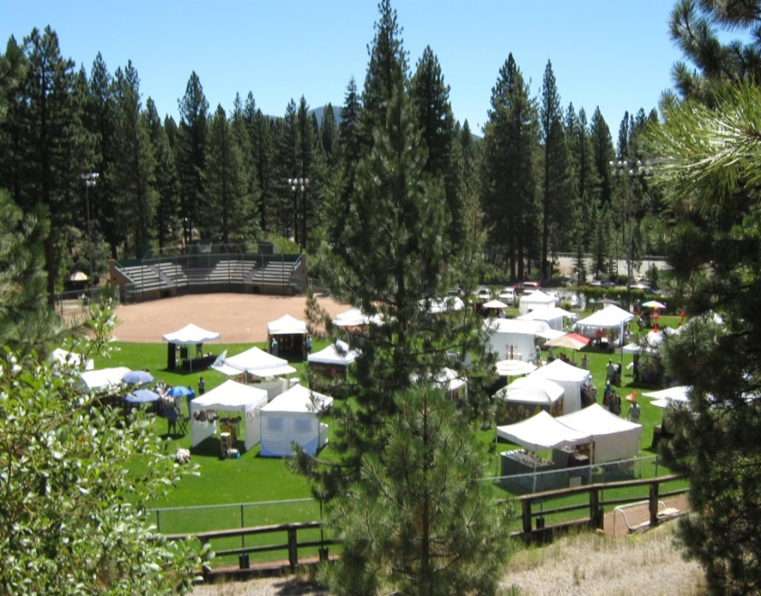
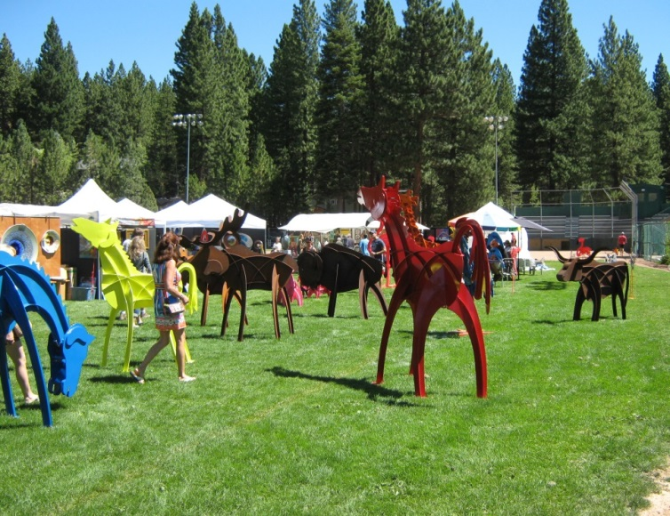
WADMIN19-0007
Sixth year of event
29 vendors
Approximately 400 people per day
No amplified sound
No lighting
2014 Incline Arts Festival at Preston Field

Slide 3
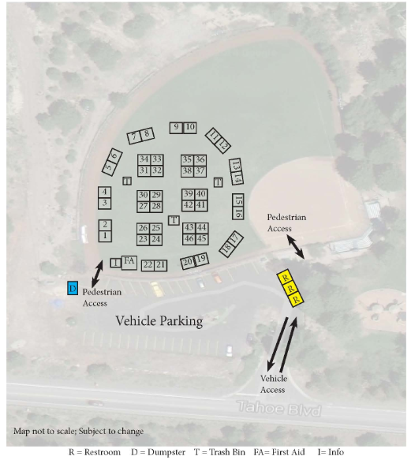
Site Layout

Slide 4
Motion
I move that after giving reasoned consideration to the information contained in the staff report, information received during the public hearing, and subject to the conditions contained as Attachment A in the staff report, the Board of Adjustment approve WADMIN19-0007 for the Incline Village Fine Art Festival, having made all four findings in accordance with Washoe County Development Code Section 110.808.25:
1. Consistency
Improvements
Site Suitability
Issuance Not Detrimental

